Slide 1
CodeU’s
Bootcamp
Chapter 2
Welcome to your 4th session!
The class will start shortly...
Reproduction and distribution of the presentation deck is prohibited

Slide 2
Agenda for today’s class
Kahoot!
01
02
Homework correction
To recap what was seen last class!
Let’s correct last week’s homework!
Topic of the day:
03
04
Practice time!
-While Loop Exercises
Let’s practice with some coding exercises!
Wrap-up
Conclusion
05
06
CodeU Robot
Summary of what we’ve learned today
homework and questions

Slide 3
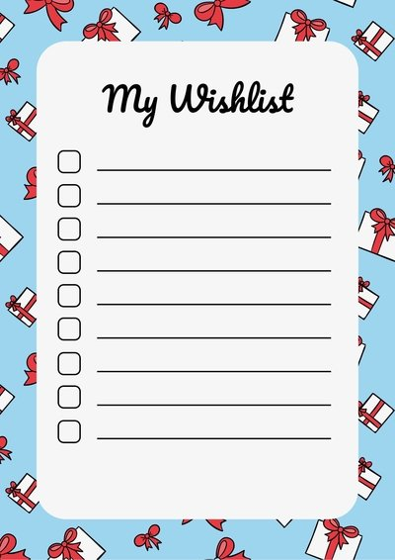
Homework : Create a Wish List!
Homework Description
You must build a Wish List Maker for anyone that would like to make a list of presents they would love to receive in the future!
Solution
#Create an empty list
gifts = []
#Create a while loop that ends once the length of the list reaches 5
while len(gifts) <= 5:
#Ask the user for a gift to add using input. Then append to your list
new_gift = input("What gift would you like to add to your wish list: ")
gifts.append(new_gift)
print("Here is your final wish list: " + gifts)

Slide 4

Time for Kahoot!
Head over to Kahoot.it for a fun coding quiz!

Slide 5
Recap: While Loops
What is a LOOP?
A loop is a sequence of instructions that is continually repeated until a certain condition is reached.
Example
You ask your mom to buy chips. She says no. You keep asking until she says yes. Once she says yes, you stop asking. The condition here is that she says yes!
Syntax for While loops
while mom == “No”:
print(“Can we please buy some chips”)
**In this scenario, once the mom’s answer is anything other than “No”, the loop stops. If the mom keeps answering “No”, the loop will continue and the print() statement will be repeated.

Slide 6

Guessing Game!
01
In the first exercise, we will create a Guessing Game where we must guess the right number between 1 and 10 using the WHILE Loop and the Random Module.
Random Module: The Random module allows to randomly select a value. In this case, the computer will randomly choose a number between 1 and 10.
You must import the Random Module
You then have to create a variable for the random number using random.randrange(First Number, Last Number)
Ask the user to choose a number between 1 and 10 using Input()
Create the WHILE Loop that will end once the user’s answer is the same as the random number determined by random.randrange()
Remember that the loop repeats the question until the answer is correct!

Slide 7

Metaverse Contest!
02
You must import the Random Module
You then have to create variables for the number of tries (tries) and for the random number using random.randrange(First Number, Last Number)
Create an input() variable where the user is asked to call the Radio Station
Create a conditional (IF) where if the user’s input is “call”, it prints “Thank you for calling”
Create a WHILE Loop inside the conditional.
Inside the Loop, create a conditional where if their answer is correct, it prints “Congratulations!! You now have access to the METAVERSE :)”. If the answer is incorrect, they have one less try.
This process repeats until they’ve used 3 tries!
Description
The Metaverse, an online virtual reality environment, is ready for more users! They’ve asked you to create a contest where the prize is a ticket to the Metaverse! Users will have to call in to the Metaverse Radio Station and guess the correct number. They are only allowed 3 tries!

Slide 8

Homework: Defeat the Final Boss! (HARD)
Homework Description
You must build a game where a user must face a final boss. In this dual, the player must guess the boss's number to attack!
Requirements
The final boss has a total of 5 lives (Create a variable). This means the WHILE loop will end when his lives reach 0.
01
02
The final boss's number is generated randomly between 1 and 10.
After each user guess (done with input), the boss's number changes. HINT: This means that the random.randrange has to be repeated after each guess.
03
04
Your attack takes a life off of the boss.
05
Print 'You have defeated the boss!’ when you have defeated the boss.

Slide 9




Thank you!
Does anyone have any questions?
Next class: Class 5
Please contact us if you have any questions or if you want to notify us for anything.
Phone:
(438) 391-9106
Email:
hello@codeu.ca

